Slide 1


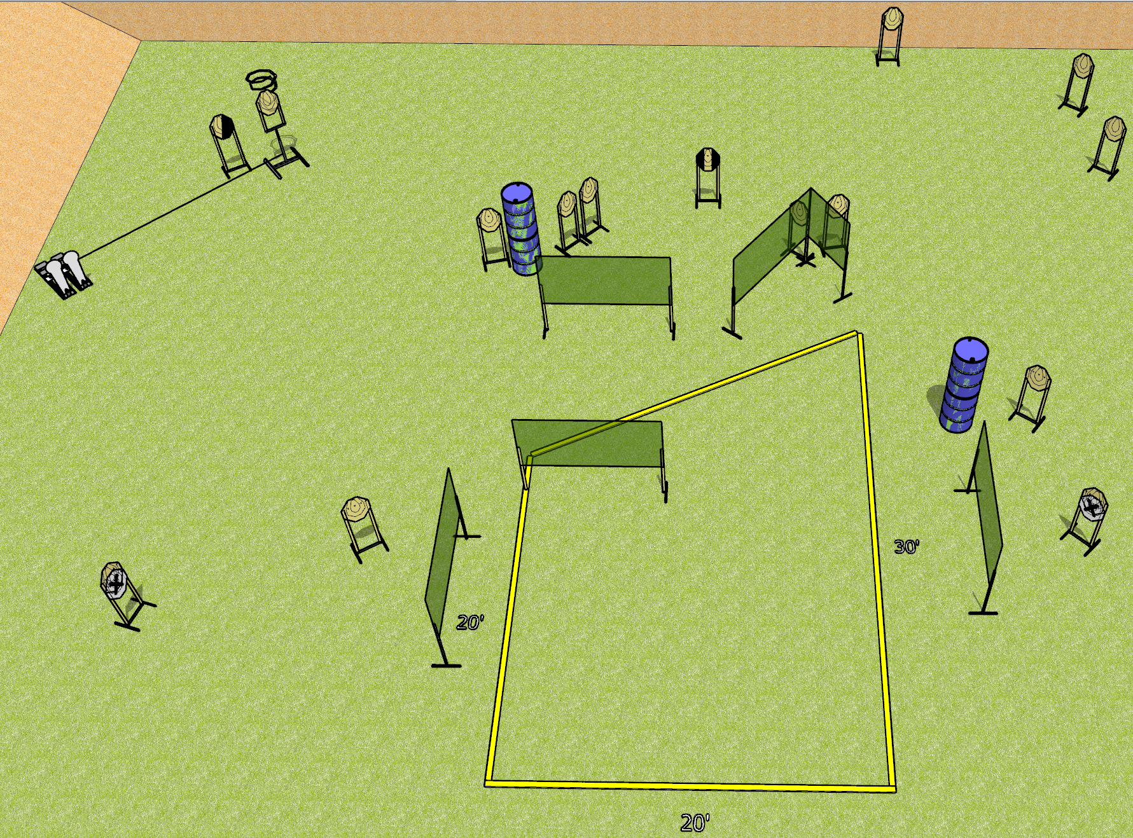
 | Dothan Gun Club – USPSA Match See What Sticks Course Designer : Drew Coleman
Round Count 32 rounds 15 IPSC 2 colt poppers
Equipment List 12 wall feet Drop turner + activator 1 tuxedo, 1 right diagonal

Slide 2
See What Sticks
Written Stage Briefing
See What Sticks is a 32 round, 160 point, Comstock course of fire. There are 15 IPSC targets and 2 colt poppers. The best 2 hits on paper will score, and steel must fall to score.
The drop turner is activated by the right colt popper, and is a disappearing target.
Handgun start position is inside the shooting area, wrists below belt. Handgun is loaded and holstered.
PCC start position is inside the shooting area, stock on belt. Loaded carbine is held with both hands, safety on.
On start signal, engage targets as they become available from within the shooting area.

